Slide 1

Made by:
Tanya Mishra
Sejal Thatera
Ansh Tiwari
Prayag Mayekar

Slide 2
abstarct
PetDote - An e-commerce website for pet products.
It's a website that is dedicated to pet products. It includes safe and pet-friendly food and hygiene-related products with their pictures and prices. users can directly buy the desired things or add them to the cart for future purchases.
The goal of this project is to develop a website for pet parents to get all the required products for their pets in one place. The common features of this e-commerce site include the displaying of available products with their specific pictures and prices, the option to buy them, add them to the shopping cart, payment, billing and delivery.

Slide 3
Problem statement
Nowadays for humans you can buy anything and everything online it will just get delivered very easily and when it comes to pets there are very limited options or offline stores are much safer than what they prefer
With petflix, you can order products for dogs, cats, rabbits and much more
Another problem being solved is to communicate with the vet even at midnight through a chat We assure in guarantee and in warranty products for your pets to deliver it within 24 hours and to make sure smooth and simple return policy

Slide 4
software’s to be used
The whole agenda while building a website is much more focused on the front end
And for the front end development we would be using html, css , java script
To each each and every record we could be using mysql for database storage
Django framework to be used to make migrations.

Slide 5
methodology
Django is a Model View Control (MVC) framework
•Mange.py This file is used basically as a command-line utility and for deploying, debugging, or running our web application. It contains code for run-server, or make migrations or migrations, etc. that we use in the shell. Anyway, we do not need to make any changes to the file.
•Db.sqlite3 is the database file.
•Static folder contains all the static files like CSS and images.
•Env folder is the project specific development environment. Its created through a command ’virtualenev Env’

Slide 6
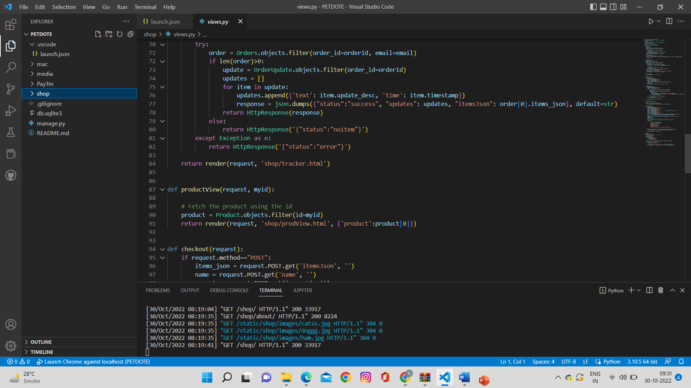
•E comm folder is the Django projects consisting of in it, admin, models, views, apps and forms. Models are basically the blueprints of the database we are using and hence containthe information regarding attributes and the fields etc of the database. Views is a crucial one, it contains all the Views (usually as classes). Views.py can be considered as a file that interacts with the client. Views are a user interface for what we see when we render a Django Web application. URLs Just like the project urls.py file, this file handles all the URLs of our web application.

Slide 7
Ecommerce folder is the Django application directory consisting of the following essentialfiles.
Init.py This file remains empty and is present them only to tell that this particulardirectory is a package.
Settings.py This file is present for adding all the applications and the middlewareapplication present. Also, it has information about templates and databases. Overall,this is the main file of our Django web application.
Urls.py This file handles all the URLs of our web application. This file has the lists ofall the endpoints that we will have for our website.
Wsgi.py This file mainly concerns with the WSGI server and is used for deploying ourapplications on to servers like Apache etc.
Asgi.py In the newer versions of Django, you will also find a file named as asgi.pyapart from wsgi.py. ASGI can be considered as a succeeded interface to the WSGI.ASGI, short for Asynchronous Server Gateway interface

Slide 8
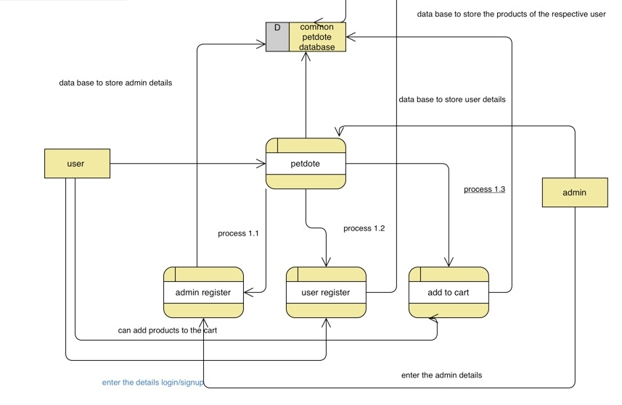
Data flow diagram

Slide 9
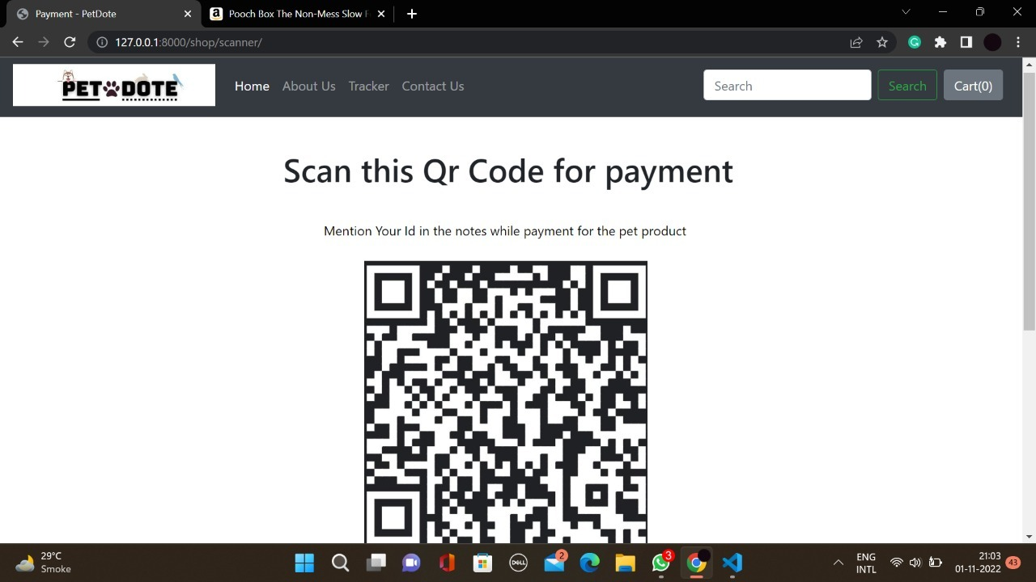
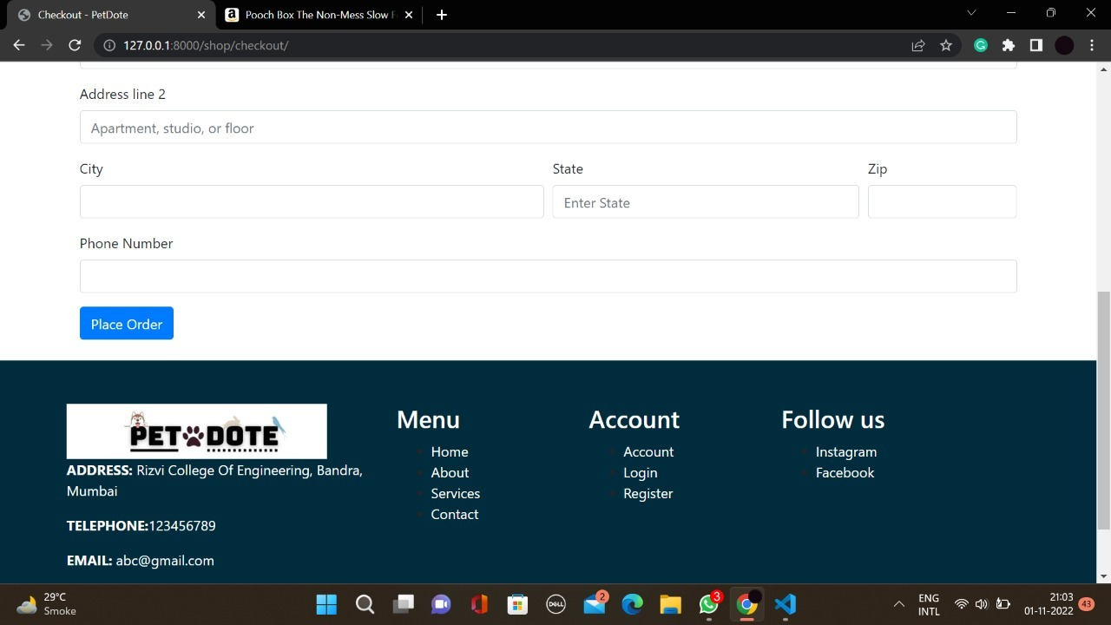
Results

Slide 10
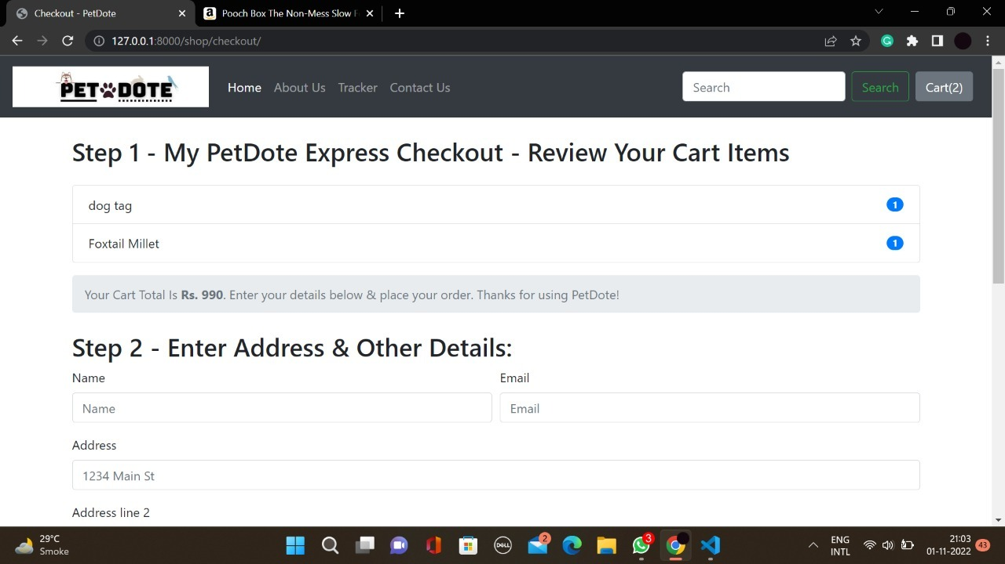
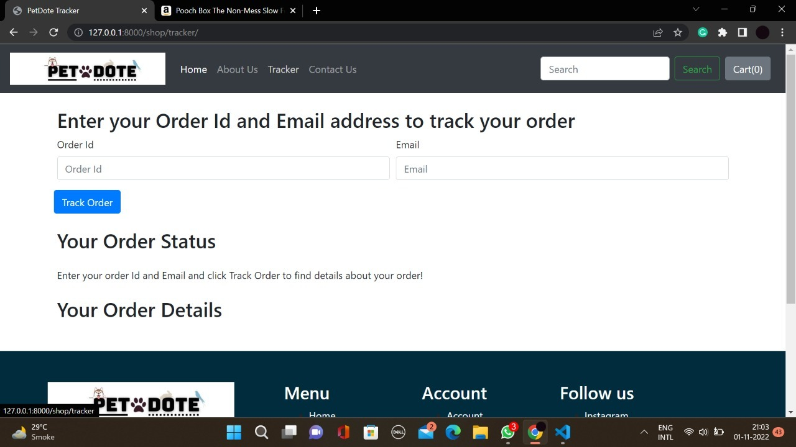

Slide 11
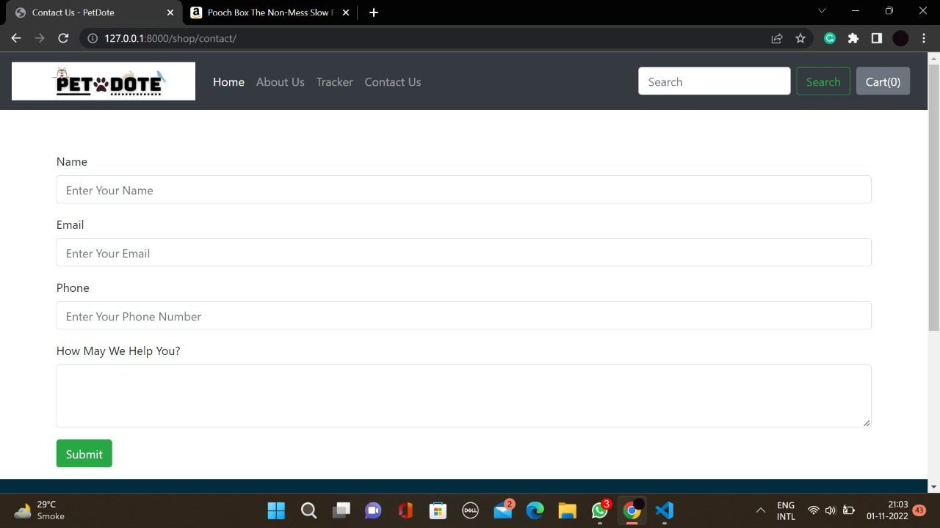
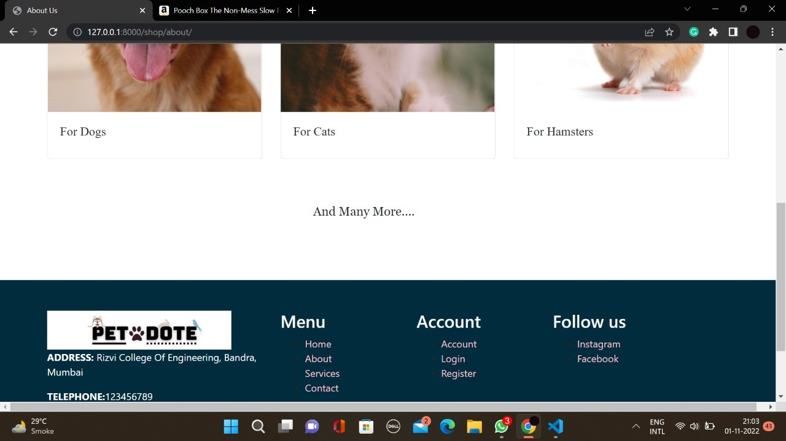

Slide 12
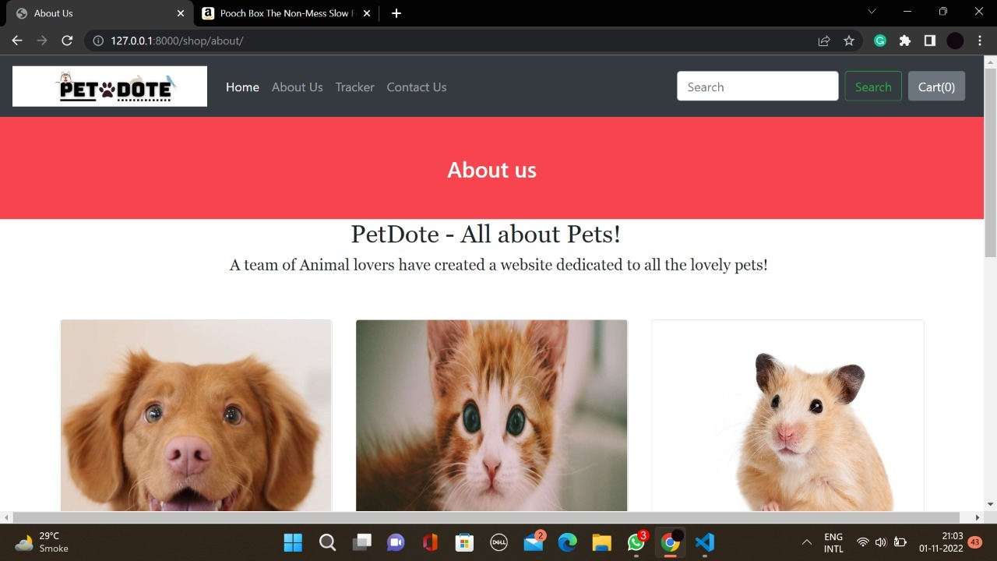
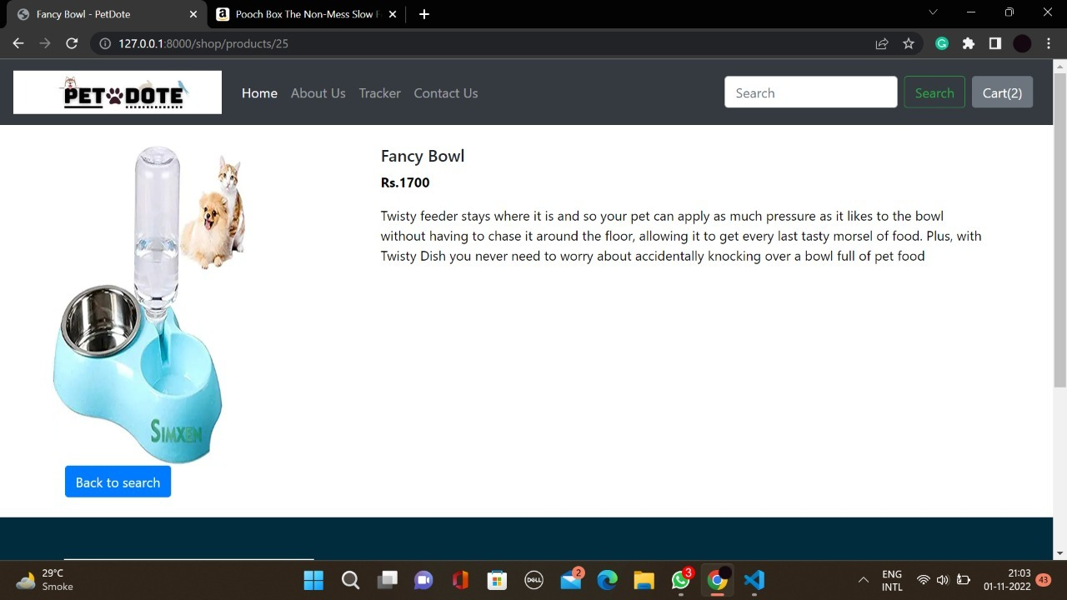

Slide 13
conclusion
The project entitled PETDOTE system was completed successfully. The system has been developed with much care and free of errors and at the same time it is efficient and less time consuming. The purpose of this project was to develop a web application for purchasing products from a pet shop. This project enabled me gain valuable information and practical knowledge on several topics like designing web pages using html & CSS, usage of responsive templates, designing of full stack Django application, and management of database using SQLite 3. The entire system is secured. Also, the project helped me understanding about the development phases of a project and software development life cycle. I learned how to test different features of a project. This project has given me great satisfaction in having designed an application which can be implemented to any nearby shops or branded shops selling various kinds of products by simple modifications. However, it was very challenging learning and developing an application using a new technology..

Slide 14
refrences
https://www.researchgate.net/publication/325659182_An_Adaptive_ECommerce_Application_using_Web_Framework_Technology_and_Machine_Learning
https://r.search.yahoo.com/_ylt=AwrwBpVb5mFjkJsA2gnnHgx.;_ylu=Y29sbwMEcG9zAzEEdnRpZAMEc2VjA3Ny/RV=2/RE=1667389147/RO=10/RU=https%3a%2f%2fonline.visual-paradigm.com%2f/RK=2/RS=Fbes.qkdZrACX7P_Jx93xooZmzU-
https://r.search.yahoo.com/_ylt=AwrxhWib7WFjNlcApAHnHgx.;_ylu=Y29sbwMEcG9zAzEEdnRpZAMEc2VjA3Ny/RV=2/RE=1667391004/RO=10/RU=https%3a%2f%2fen.wikipedia.org%2fwiki%2fPets.com/RK=2/RS=zKQ3u0GvDWupRGq_VBQrHZSSw9M-

Slide 15
THANK YOU …

